Slide 1
Battle of Neighborhood – Relocating to Toronto

Slide 2
Providing Relocation Assistance
As part of the relocation assistance, the company would like to do the research and provide the employees analysis on the Toronto neighborhood details, to take that stress of the employees and the employees will have the readymade analysis for them on the Toronto neighborhoods so they can make the decision on which neighborhood would be their new home.

Slide 3
Data Acquisition and Cleaning
Data Sources
https://en.wikipedia.org/wiki/List_of_postal_codes_of_Canada:_M
http://cocl.us/Geospatial_data/Geospatial_coordinates.csv
Data Cleaning
Extracted the Boroughs information table from the XML using BeautifulSoup package
Cleaned the data by deleting 'Not Assigned' Borough. If Neighborhood is blank, it was set same as borough. Merged the neighborhood with the same postalcode. Cleaned up the duplicates.
Using the Postalcode from the table and http://cocl.us/Geospatial_data/Geospatial_coordinates.csv file, get latitude and longitude for each Borough and Neighborhood
Using FourSquare API got a list of 100 nearby venues within 500m radius for each neighborhood

Slide 4
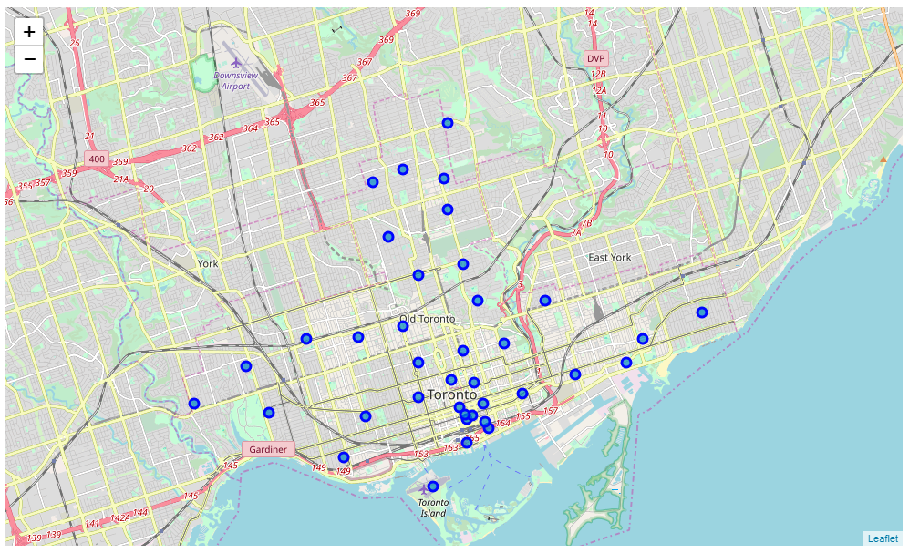
Toronto Neighborhoods Map

Slide 5
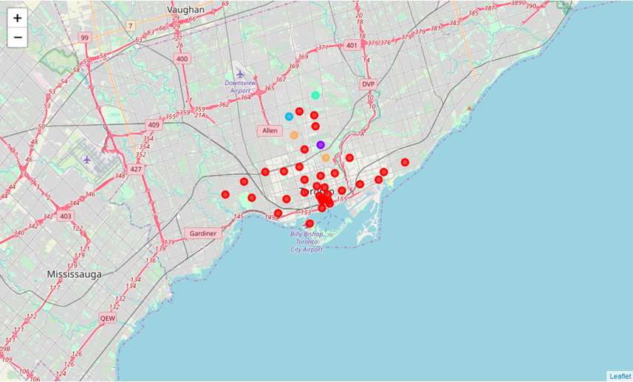
Neighborhood Clusters

Slide 6
Cluster 1

Slide 7
Cluster 2

Slide 8
Cluster 3

Slide 9
Cluster 4

Slide 10
Cluster 5

Slide 11
Discussion
The data collection and analysis gives a good understanding of the neighborhood and its vicinity. With this detail analysis, we can see each neighborhood and the top venues in those neighborhoods.
If the client needs proximity to pharmacy, super market, bank, park then West Toronto neighborhood is the best
If the client has small kids and needs proximity to kids activities then Downtown toronto is good neighborhood
If the client needs proximity to Airport, may be because he still has family back in New York and needs to visit them frequently, then Downtown Toronto is good neighborhood
If the client has pets, East Toronto is a good neighborhood.

Slide 12
Conclusion
In this study and analysis,all the neighborhoods in Toronto were explored in detailed to give a complete picture of the neighborhood and the venues nearby. It also gave a detailed analysis of the top 10 venue categories. This will help the client decide which neighborhood is best for his/her specific needs. This study will surely take some stress out of employees relocation anxiety and help them deal with the stress better.

